Slide 2
The Molecule That Supports All of Life
Water makes life possible on Earth
Water is the only common substance to exist in the natural environment in all three physical states of matter
Water’s unique emergent properties help make Earth suitable for life
The structure of the water molecule allows it to interact with other molecules

Slide 3
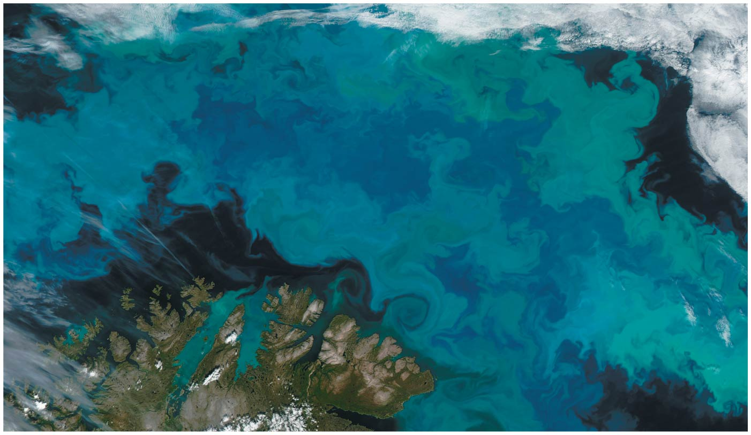
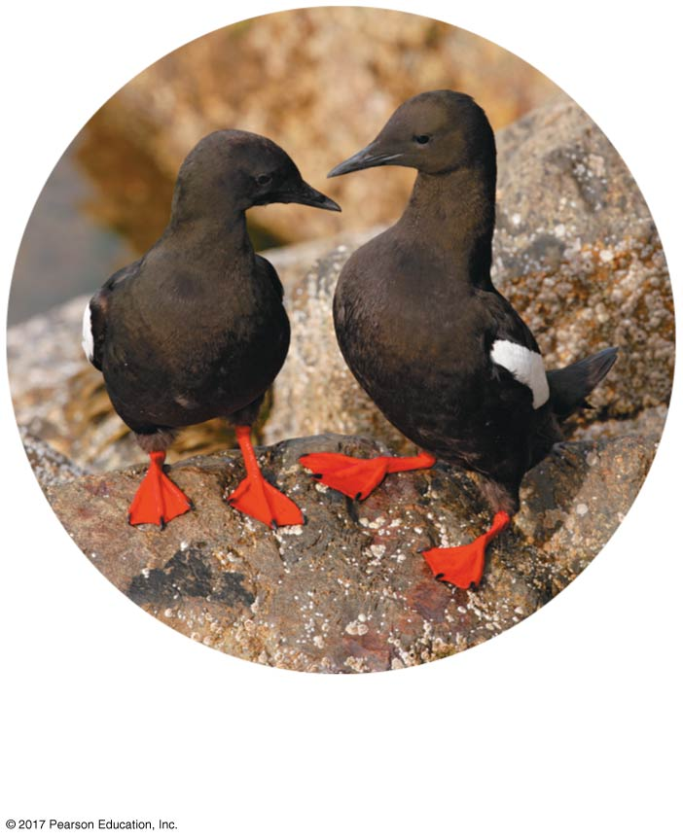
Figure 3.1
How does life on Earth depend on the chemistry of water?
Black guillemots, threatened
by climate change
Notes:
Figure 3.1 How does life on Earth depend on the chemistry of water?

Slide 4
Concept 3.1: Polar covalent bonds in water molecules result in hydrogen bonding
In the water molecule, the electrons of the polar covalent bonds spend more time near the oxygen than the hydrogen
The water molecule is thus a polar molecule極性分子:The overall charge is unevenly distributed
Polarity allows water molecules to form hydrogen bonds with each other

Slide 5
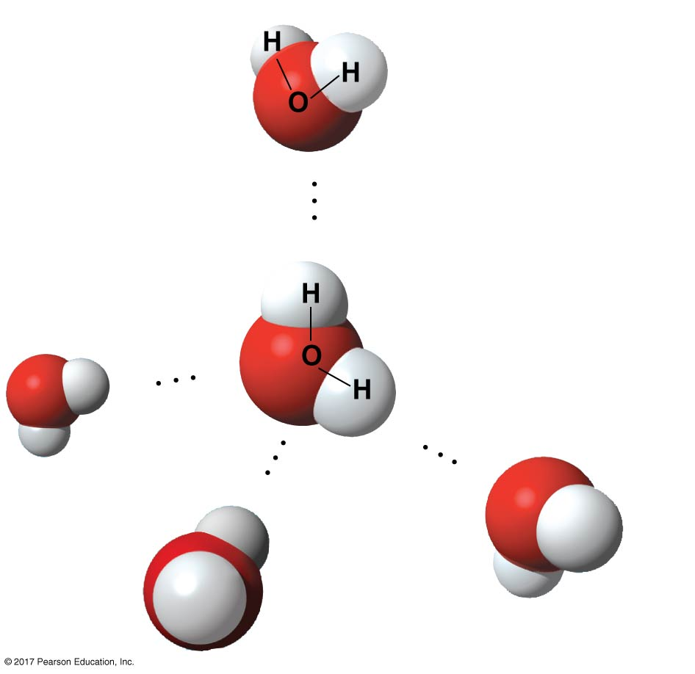
Figure 3.2
Hydrogen bonds between water molecules
δ+
δ+
Polar covalent bond
δ–
δ–
Region of partial
negative charge
Hydrogen bond
δ+
δ+
δ–
δ–
δ+
δ–
δ+
Notes:
Figure 3.2 Hydrogen bonds between water molecules

Slide 6
Concept 3.2: Four emergent properties of water contribute to Earth’s suitability for life
Four of water’s properties that facilitate an environment for life are
Cohesive behavior
Ability to moderate temperature
Expansion upon freezing
Versatility as a solvent溶劑

Slide 7
Cohesion of Water Molecules
Collectively, hydrogen bonds hold water molecules together, a phenomenon called cohesion內聚
Cohesion helps the transport of water against gravity in plants
Adhesion黏著 is an attraction between different substances, for example, between water and plant cell walls

Slide 8
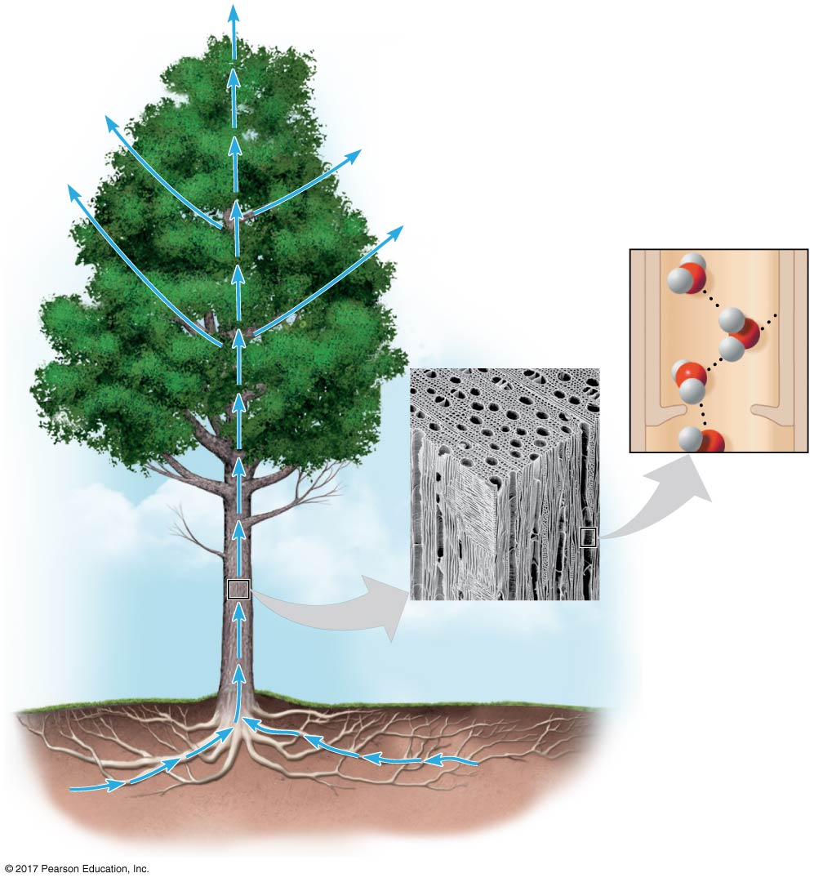
Figure 3.3
Evaporation pulls water upward.
H₂O
Adhesion
Two types of
water-conducting
cells
Direction
of water
movement
Cohesion
300 µm
H₂O
H₂O
Water transport in plants
Notes:
Figure 3.3 Water transport in plants

Slide 9
Surface tension is a measure of how difficult it is to break the surface of a liquid
Water has an unusually high surface tension due to hydrogen bonding between the molecules at the air-water interface and to the water below

Slide 10
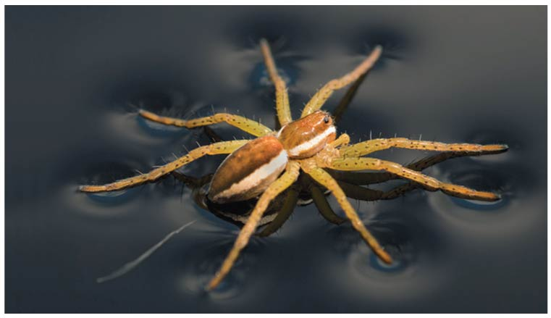
Figure 3.4
Walking on water
Notes:
Figure 3.4 Walking on water

Slide 11
Moderation of Temperature by Water
Water absorbs heat from warmer air and releases stored heat to cooler air
Water can absorb or release a large amount of heat with only a slight change in its own temperature

Slide 12
Temperature and Heat
Kinetic energy is the energy of motion
The kinetic energy associated with random motion of atoms or molecules is called thermal energy(熱能)
Temperature represents the average kinetic energy of the molecules in a body of matter
Thermal energy in transfer from one body of matter to another is defined as heat

Slide 13
A calorie (cal) is the amount of heat required to raise the temperature of 1 g of water by 1ºC
It is also the amount of heat released when 1 g of water cools by 1ºC
The “Calories” on food packages are actually kilocalories (kcal); 1 kcal = 1,000 cal
The joule (J) is another unit of energy; 1 J = 0.239 cal, or 1 cal = 4.184 J

Slide 14
Water’s High Specific Heat
The specific heat(比熱)of a substance is the amount of heat that must be absorbed or lost for 1 g of that substance to change its temperature by 1ºC
The specific heat of water is 1 cal/(g ∙ ºC)
Water resists changing its temperature because of its high specific heat

Slide 15
Water’s high specific heat can be traced to hydrogen bonding
Heat is absorbed when hydrogen bonds break
Heat is released when hydrogen bonds form
The high specific heat of water minimizes temperature fluctuations to within limits that permit life

Slide 16
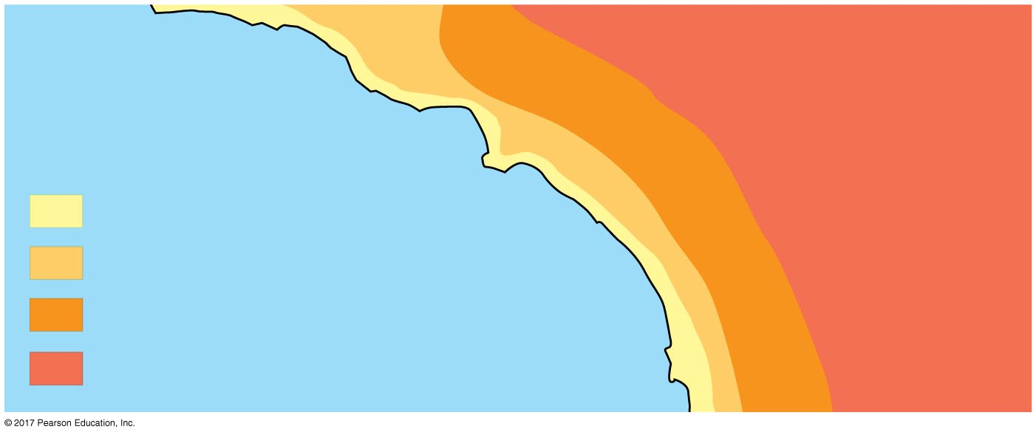
Figure 3.5
Temperatures for the Pacific Ocean and Southern California on an August day
Burbank
San Bernardino
Santa Barbara 73º
90º
100º
Los Angeles
Riverside 96º
(Airport) 75º
Santa Ana
Palm Springs
70s (ºF)
84º
106º
80s
Pacific Ocean 68º
90s
100s
San Diego 72º
40 miles
Notes:
Figure 3.5 Temperatures for the Pacific Ocean and Southern California on an August day

Slide 17
Evaporative Cooling
Evaporation (or vaporization) is transformation of a substance from liquid to gas
Heat of vaporization蒸發熱is the heat a liquid must absorb for 1 g to be converted to gas
As a liquid evaporates, its remaining surface cools, a process called evaporative cooling
Evaporative cooling of water helps stabilize temperatures in organisms and bodies of water

Slide 18
Floating of Ice on Liquid Water
Ice floats in liquid water because hydrogen bonds in ice are more “ordered,” making ice less dense than water
Water reaches its greatest density at 4ºC
If ice sank, all bodies of water would eventually freeze solid, making life impossible on Earth

Slide 19
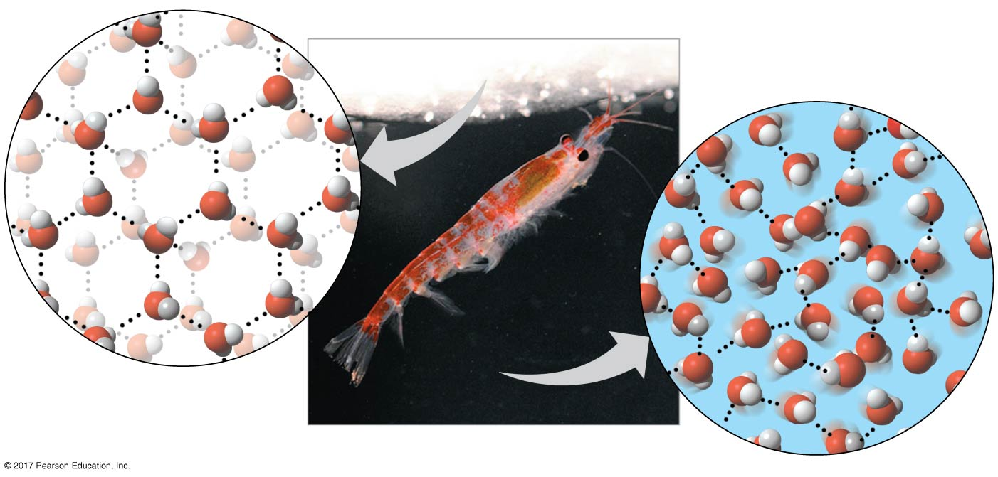
Figure 3.6
Ice: crystalline structure and floating barrier
Hydrogen bond
Liquid water:
Hydrogen bonds
break and re-form
Ice:
Hydrogen bonds
are stable
krill
Notes:
Figure 3.6 Ice: crystalline structure and floating barrier

Slide 20
Many scientists are worried that global warming is having a profound effect on icy environments around the globe
The rate at which glaciers and Arctic sea ice are disappearing poses an extreme challenge to animals that depend on ice for their survival

Slide 21
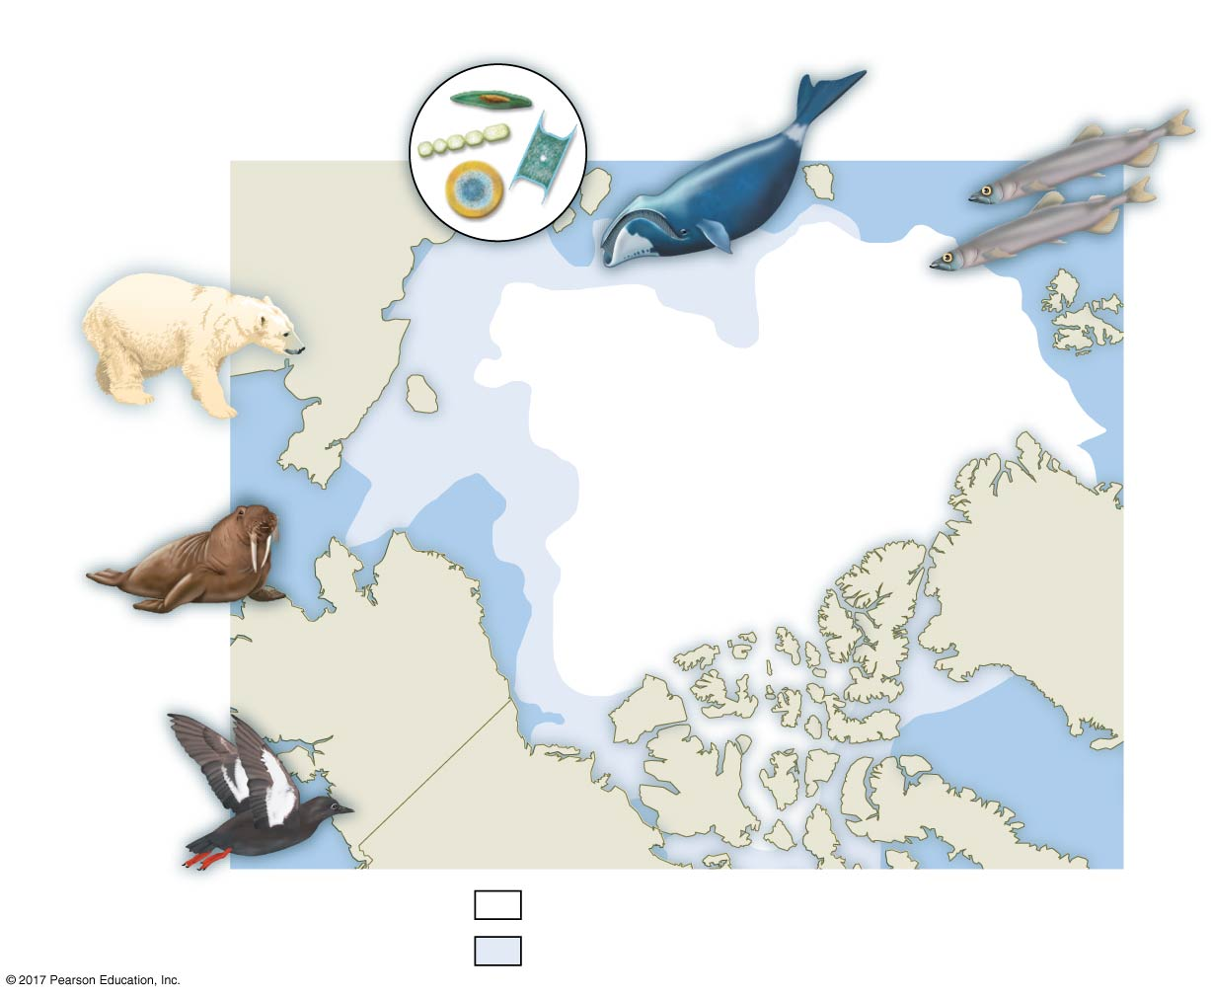
Figure 3.7
Effects of climate change on the Arctic
Benefiting from loss of ice:
Phyto-
plankton
Bowhead
whales
Capelin
Harmed by
loss of ice:
Russia
Arctic
ocean
Extent of sea ice in Sept. 2014
Extent of sea ice in Sept. 1979
Polar bears
Bering
Strait
North Pole
Greenland
Pacific walrus
Alaska
Black
guillemots
Canada
Sea ice in Sept. 2014
Ice lost from Sept. 1979 to Sept. 2014
Notes:
Figure 3.7 Effects of climate change on the Arctic

Slide 22
Water: The Solvent of Life
A solution溶液 is a liquid that is a completely homogeneous mixture of substances
The solvent溶劑 is the dissolving agent of a solution
The solute溶質 is the substance that is dissolved
An aqueous solution水溶液 is one in which water is the solvent

Slide 23
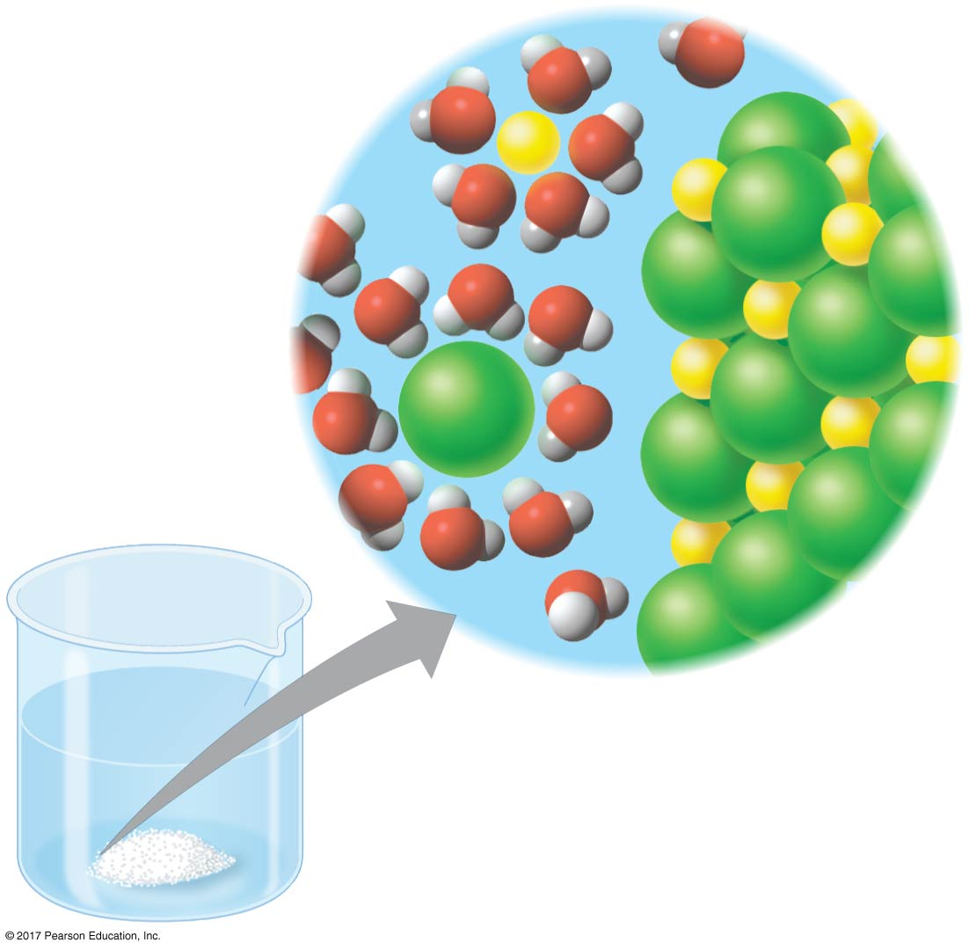
Figure 3.8
Table salt dissolving in water
–
Na⁺
+
+
–
–
+
–
–
Na⁺
–
+
+
CI–
CI–
+
–
–
+
–
+
–
–
Notes:
Figure 3.8 Table salt dissolving in water

Slide 24
Water is a versatile solvent due to its polarity
When an ionic compound is dissolved in water, each ion is surrounded by a sphere of water molecules called a hydration shell水合外層

Slide 25
Water can also dissolve compounds made of nonionic polar molecules
Even large polar molecules such as proteins can dissolve in water if they have ionic and polar regions

Slide 26
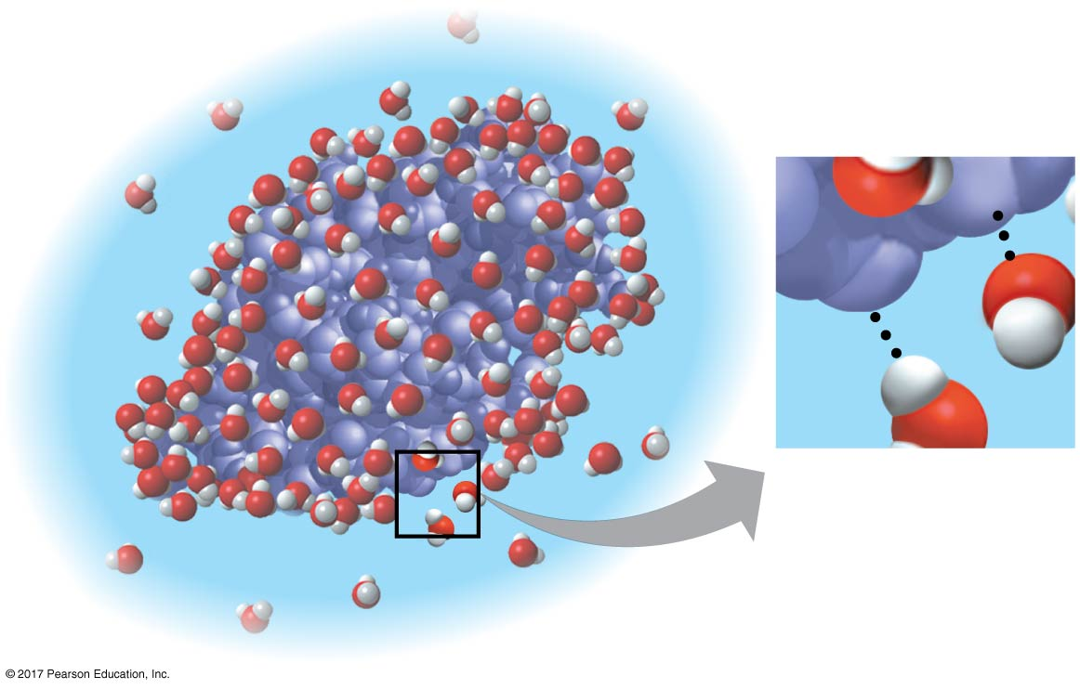
Figure 3.9
A water-soluble protein
δ+
δ–
δ–
δ+
Notes:
Figure 3.9 A water-soluble protein

Slide 27
Hydrophilic and Hydrophobic Substances
A hydrophilic親水性 substance is one that has an affinity for water
A hydrophobic疏水性 substance is one that does not have an affinity for water
Oil molecules are hydrophobic because they have relatively nonpolar bonds
Hydrophobic molecules related to oils are the major ingredients of cell membranes

Slide 28
Solute Concentration in Aqueous Solutions
Most chemical reactions in organisms involve solutes dissolved in water
When carrying out experiments, we use mass to calculate the number of solute molecules in an aqueous solution

Slide 29
Molecular mass is the sum of all masses of all atoms in a molecule
Numbers of molecules are usually measured in moles, where 1 mole (mol) = 6.02 × 10²³ molecules
Avogadro’s number and the unit dalton were defined such that 6.02 × 10²³ daltons = 1 g
Molarity體積莫耳濃度(M) is the number of moles of solute per liter of solution

Slide 30
Possible Evolution of Life on Other Planets
Biologists seeking life on other planets have concentrated their search on planets that might have water
More than 800 planets have been found outside our solar system; there is evidence that a few of them have water vapor
In our solar system, Mars has been found to have water

Slide 31
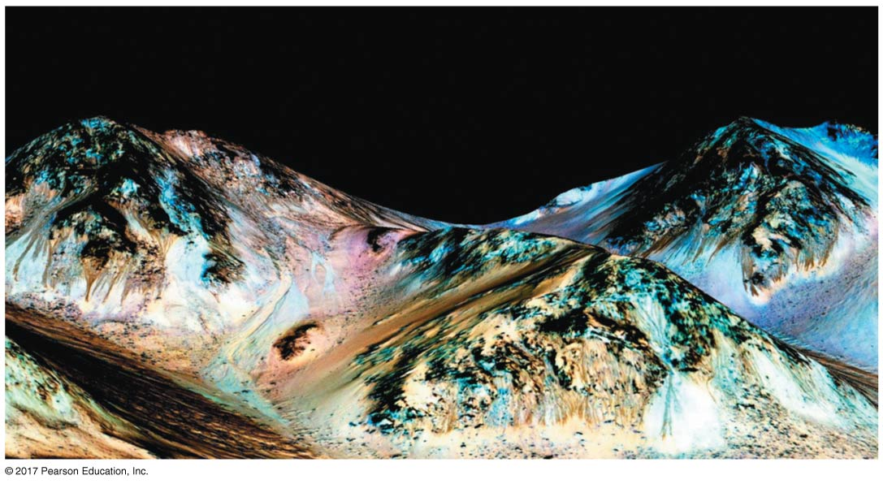
Figure 3.10
Evidence for liquid water on Mars
Dark streaks
Notes:
Figure 3.10 Evidence for liquid water on Mars

Slide 32
Concept 3.3: Acidic and basic conditions affect living organisms
A hydrogen atom in a hydrogen bond between two water molecules can shift from one to the other
The hydrogen atom leaves its electron behind and is transferred as a proton, or hydrogen ion (H⁺)
The molecule that lost the proton is now a hydroxide ion (OH–)
The molecule with the extra proton is now a hydronium ion (H₃O⁺), though it is often represented as H⁺

Slide 33
Water is in a state of dynamic equilibrium in which water molecules dissociate at the same rate at which they are being reformed

Slide 34
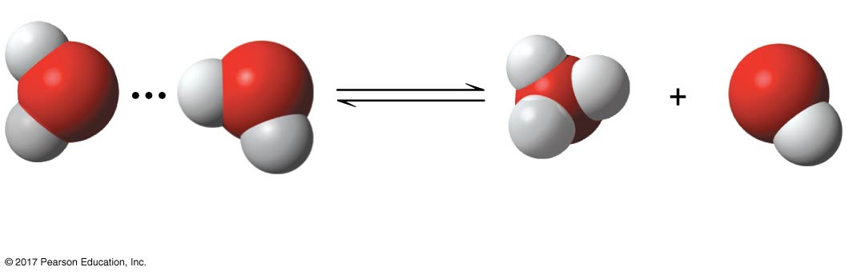
Figure 3.UN01
Dissociation of water
+
–
H
H
O
H
O
O
H
O
H
H
H
H
2 H₂O
Hydronium
ion (H₃O⁺)
Hydroxide
ion (OH–)
Notes:
Figure 3.UN01 In-text figure, dissociation of water, p. 99

Slide 35
Though statistically rare, the dissociation of water molecules has a great effect on organisms
Changes in concentrations of H⁺ and OH– can drastically affect the chemistry of a cell

Slide 36
Concentrations of H⁺ and OH– are equal in pure water
Adding certain solutes, called acids and bases, modifies the concentrations of H⁺ and OH–
Biologists use the pH scale to describe whether a solution is acidic or basic (the opposite of acidic)

Slide 37
Acids and Bases
An acid is a substance that increases the H⁺ concentration of a solution
A base is a substance that reduces the H⁺ concentration of a solution
Strong acids and bases dissociate completely in water
Weak acids and bases reversibly release and accept back hydrogen ions, but can still shift the balance of H⁺ and OH– away from neutrality

Slide 38
The pH Scale
In any aqueous solution at 25ºC, the product of H⁺ and OH– is constant and can be written as
[H⁺][OH–] = 10^{–14}
The pH of a solution is defined by the negative logarithm of H⁺ concentration, written as
pH = –log [H⁺]
For a neutral aqueous solution, [H⁺] is 10^{–7}, so
pH = –(–7) = 7

Slide 39
Acidic solutions have pH values less than 7
Basic solutions have pH values greater than 7
Most biological fluids have pH values in the range of 6 to 8

Slide 40
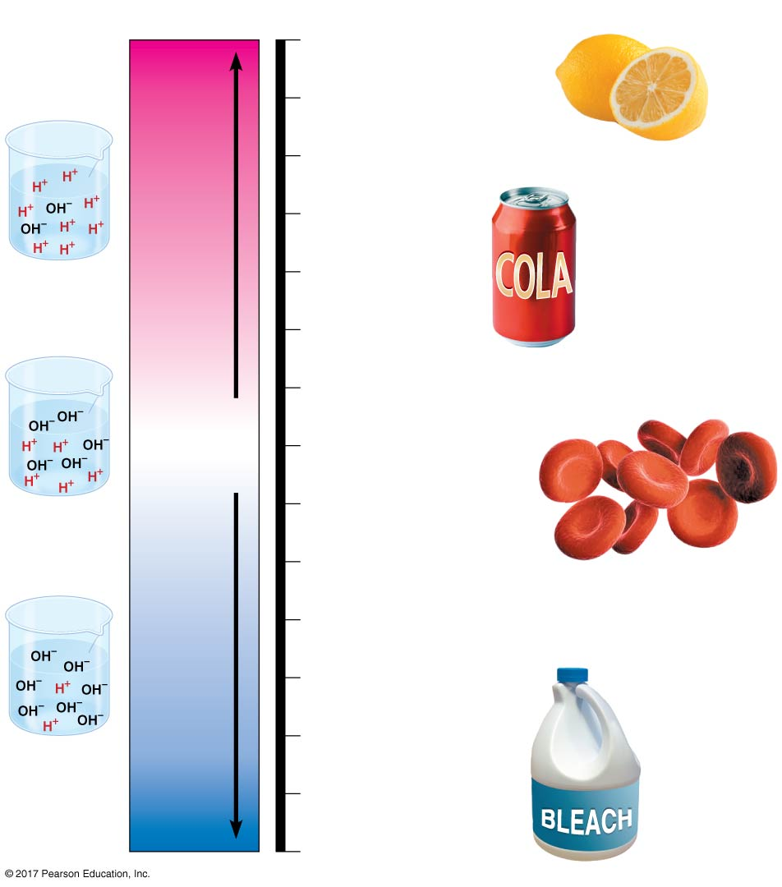
Figure 3.11
pH Scale
0
1
Battery acid
2
Gastric juice (in stomach),
lemon juice
Increasingly Acidic
[H⁺] > [OH–]
3
Vinegar, wine,
cola
Acidic
solution
4
Tomato juice
Beer
5
Black coffee
Rainwater
6
Urine
Neutral
Saliva
[H⁺] = [OH–]
7
Pure water
Human blood, tears
Neutral
solution
8
Seawater
Inside small intestine
9
Increasingly Basic
[H⁺] < [OH–]
10
Milk of magnesia
11
Household ammonia
Basic
solution
12
Household
bleach
13
14
Oven cleaner
Notes:
Figure 3.11 The pH scale and pH values of some aqueous solutions

Slide 41
Buffers
The internal pH of most living cells is close to 7
Buffers are substances that minimize changes in concentrations of H⁺ and OH– in a solution
Most buffer solutions contain a weak acid and its corresponding base, which combine reversibly with H⁺ ions

Slide 42
Acidification: A Threat to Our Oceans
Human activities such as burning fossil fuels threaten water quality
CO₂ is the main product of fossil fuel combustion
About 25% of human-generated CO₂ is absorbed by the oceans
CO₂ dissolved in seawater forms carbonic acid; this process is called ocean acidification

Slide 43
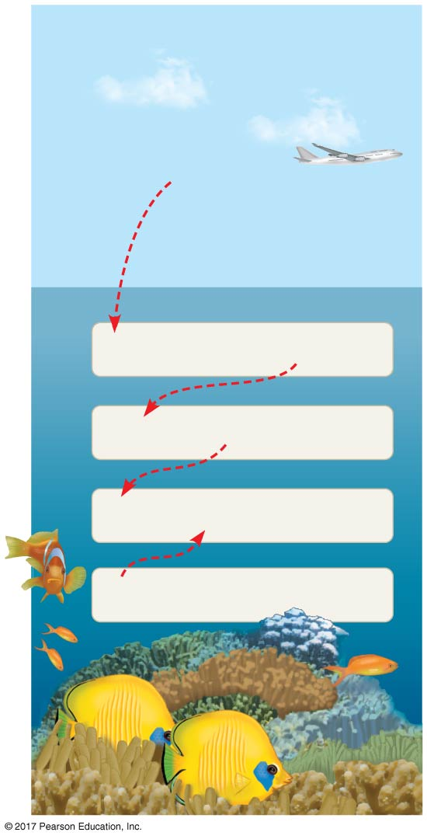
Figure 3.12
Atmospheric CO₂ from human activities and its fate in the ocean
CO₂
CO₂ + H₂O
H₂CO₃
H₂CO₃
H⁺ + HCO₃–
H⁺ + CO₃^{2–}
HCO₃–
CO₃^{2–} + Ca²⁺
CaCO₃
Notes:
Figure 3.12 Atmospheric CO₂ from human activities and its fate in the ocean

Slide 44
As seawater acidifies, H⁺ ions combine with carbonate碳酸鹽ions to produce bicarbonate碳酸氫鹽
Carbonate is required for calcification (production of calcium carbonate) by many marine organisms, including reef-building corals
We have made progress in learning about the delicate chemical balances in oceans, lakes, and rivers

